Slide 1
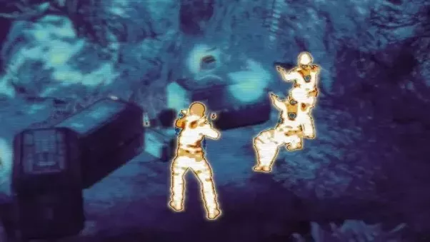
Detecting Human Presence using Sensor data
Anupriya Thirumurthy, Atif Butt, Aziz Abdul Malik, Natasha Nath

Slide 2
Agenda
Project Objective
Business Case
Exploratory Analysis
Classification Models
Model Building and Selection
Validation
Conclusion & Future Work

Slide 3

Project Objective
Detect human presence in real-time based on the sensor data received from a room.
The sensors are installed to collect the below data -
Humidity
Temperature
CO2
Light
Humidity Ratio

Slide 4
Business Case
Used in real-time for home automation and building smarter homes
In case of any security breach, sensor can send signal in realtime to relevant authorities
1
3
Detect threats without putting anyone physically in danger (e.g rescue operations)
In military domain to create automated weapons
2
4

Slide 5
Exploratory Analysis & Variable selection
Understanding the sensor data

Slide 6
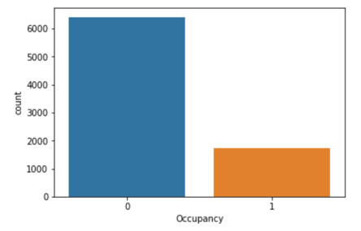
Target distribution
21% of the labelled data corresponds to a human presence detected
79% of the data corresponds to unoccupied human presence

Slide 7
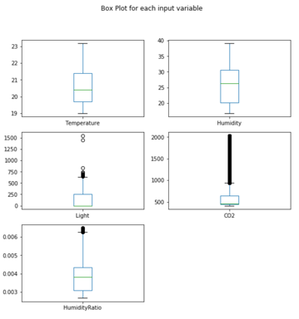
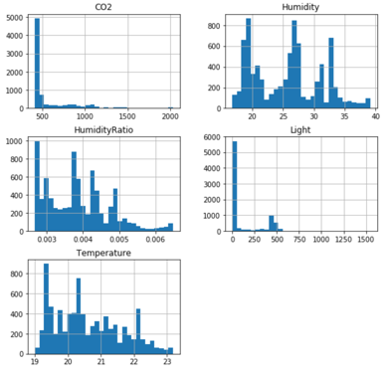
Distribution of Input variables
Temperature, Humidity and HumidityRatio have a nearly gaussian distribution

Slide 8
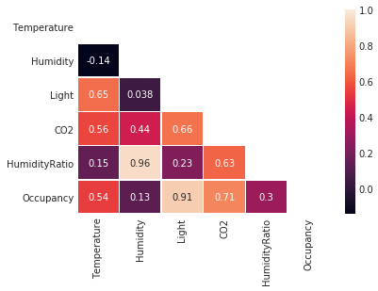
Variables correlation
From the heatmap we can notice that there is high correlation between HumidityRatio and Humidity, so we can keep one of these two predictors for modeling
The response variable “Occupancy” is highly correlated with “Light”
Occupancy also has a positive correlation with “CO2”
Based on correlation analysis, we think “Light” and “CO2” are good candidates to predict room occupancy
Notes:
From the heatmap we can observe >0.5 correlation for the below pairs -
Light and temperature
Humidity and HumidityRatio
Light and CO2
HumidityRatio and CO2
Light and CO2 are highly correlated with Occupancy

Slide 9
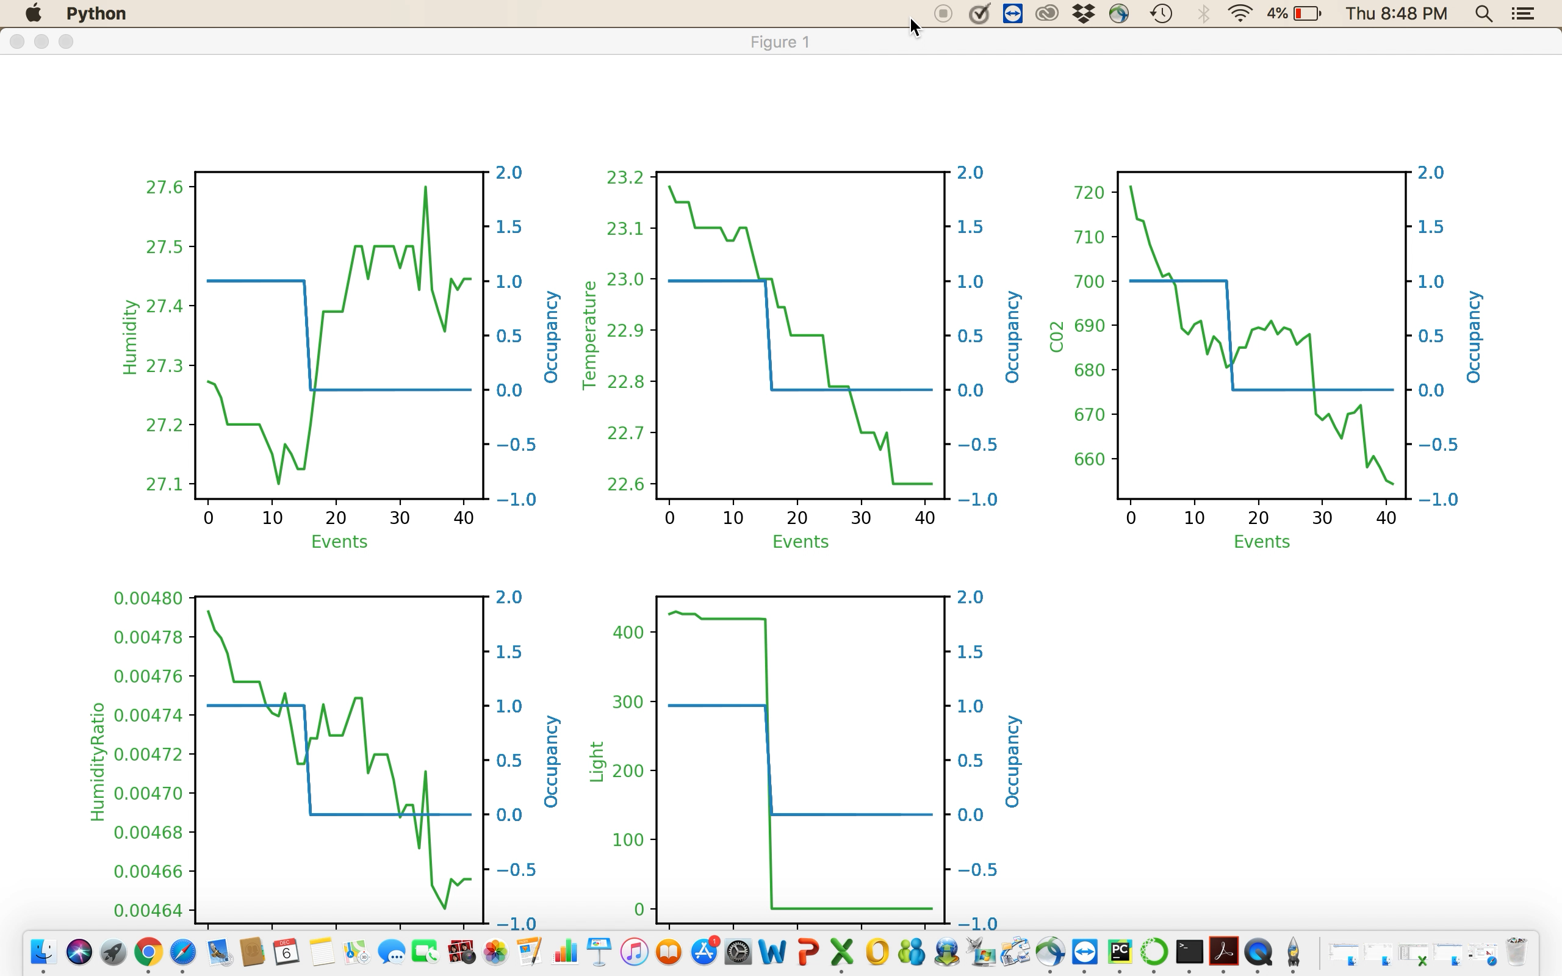
Simulation of Train Data
From the correlation analysis, we have seen that “Occupancy” is highly correlated with “Light”. Simulation of train data also indicates that “Occupancy” closely follows “Light”
Notes:
Run the video

Slide 10
Proposed solution
Building classification model

Slide 11
Model Building Steps
Split the training dataset into train (75%) and test (25%)
Fit Logistic Regression, Decision Trees, LDA, GNB, SVM, RF and Ensemble model to train dataset
Using the model, we predicted on the test dataset
Accuracy, precision and recall were used for best model selection
We trained the best model on the entire training dataset using real time environment
03

Slide 12
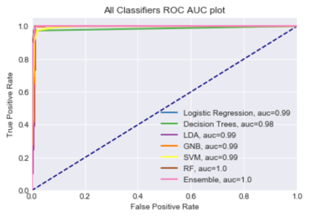
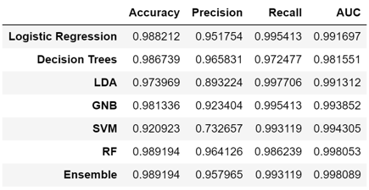
Model Evaluation and Selection
03
Model Selection:
Logistic Regression
High Recall - 99.5%
Precision, accuracy, recall and AUC are also high
Ease of interpretation

Slide 13
Test the solution
Model Validation

Slide 14
Model Validation
Used logistic regression model to predict the “Occupancy” of the room in real-time (test environment).
The server responds with the total count of predictions correctly matched.
Final accuracy is calculated based on the matched count.

Slide 15
Conclusion
Future Work
The logistic regression model predicts the presence of human with high precision and high recall
The results indicate a robust system to detect the presence of humans in real-time
Light sensor coupled with CO2 is sufficient to predict Occupancy as it has the highest predictive power (Additional sensor/ Predictors doesn’t add any value to the model)
Based on the business case, we can switch the evaluation criteria between precision and recall
Parallelize the execution using multi threading to save execution time
Additional sensor technologies should be deployed that can provide more variables to predict the count of people in an occupied room

Slide 16
Thank you.

Slide 17
Extra models
Appendix

Slide 18
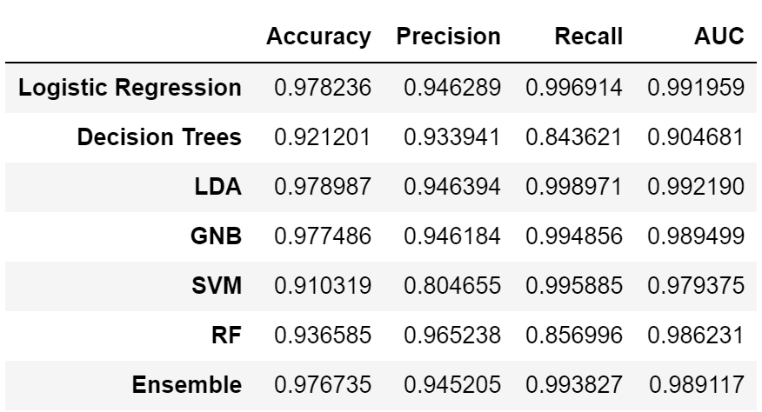
Model Statistics - Models with all parameters
01
03
02

Slide 19
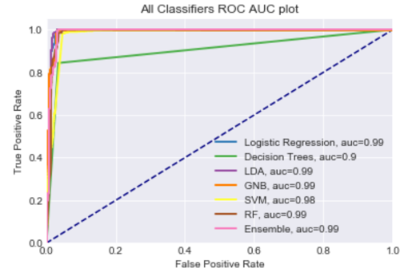
Model Statistics - Models with all parameters
01
03
02

Slide 20
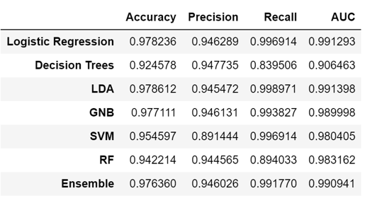
Model Statistics - 2 parameter model
01
03
02

Slide 21

Model Statistics - 2 parameter model
01
03
02

